Slide 1
Nuclear Fuel as a Resource

Slide 2
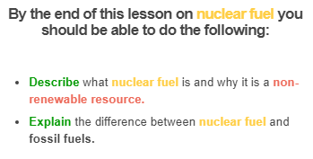


Slide 3
Here's a brief summary of how nuclear power plants work:
1. | Uranium is mined and made into rods. These are placed into the core of the nuclear power plant.
2. | A reaction occurs within the uranium rods. This produces lots of heat.
3. | The heat evaporates the water surrounding the core, producing steam.
4. | The steam turns a turbine, which produces electricity!

Slide 4
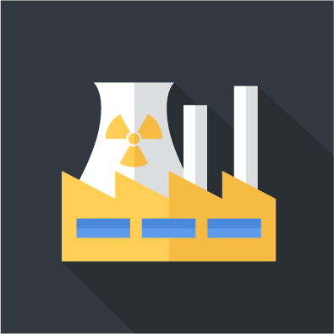
Uranium is a type of nuclear fuel. Other elements, like plutonium, can also be used as nuclear fuel.
Nuclear fuel is a non-renewable resource. This is because elements like uranium and plutonium take an extremely long time to form.

Slide 5
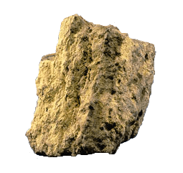
Nuclear fuel is different from other non-renewable fuels such as petrol and coal.
This is because uranium is extracted from uranium ore, which is a type of rock. All other non-renewable fuels are fossil fuels, which are formed from plants and animals which were buried millions of years ago.

Slide 6
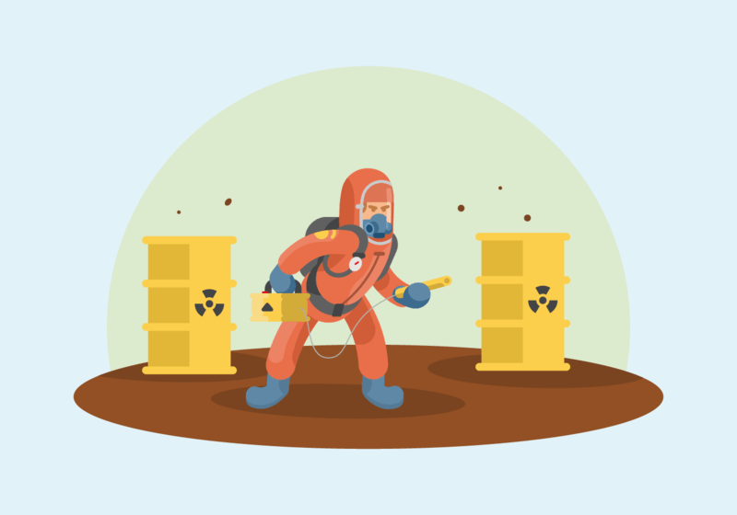
Nuclear waste is produced from nuclear fuel which has been used in a power plant.
Nuclear waste is extremely dangerous.
If you stood a few metres away from unshielded nuclear waste which came straight out of a nuclear power plant you would die.

Slide 7
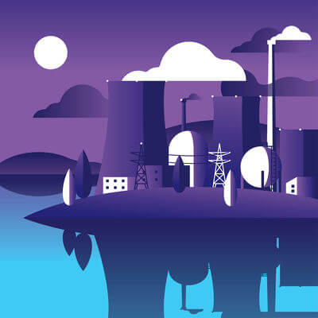
This means that it's really important to store nuclear waste where it won't harm anyone or anything.

